Slide 1
While we were asleep…. The devil crept in.
The devil is in the detail..
In everything we knew and have been taught… and what WE pay attention to, by;
Touch - what we apply to our bodies, contact with chemicals.
Smell - man made chemicals, air pollutions, unnatural fragrances.
Taste - that which enters our mouths.
Hear – Education, Religion, Mainstream government owned media, by commentary of LIES.
See – Newspapers, Television, all Smart devices.
Yes! Our Five SENSES… Did you know there is a sixth sense in the Human mind? Can you guess what it is??

Slide 2
YOU HAVE A CHOICE, stand under the statutory system or under common law.
Stand as a legal fiction entity (you don’t exist) or as a ‘living’ man or woman.
There is NO RECORD of your birth under common law, the statutory system have you and for the privilege they demand you register your birth, or they fine you.
Record your details with the Common Law Court for preservation, you can do so under the Birth Certificate category. There is NO CHARGE for this service. YOU HAVE A CHOICE, under the statutory system you are bound by their rules, you pay their fines, your pay their charges and you do as you’re told.
Under common law, we are all treated the same, as a man or a woman. There is no special treatment for the privileged, the law is common to all and everyone is held accountable for unlawfully behaviour.
NOW THERE’S A THOUGHT, HOW OFTEN ARE CORRUPT OFFICIALS HELD ACCOUNTABLE?
Reclaim Your Name
October 11, 2017
You can now RECLAIM YOUR NAME by submitting your application to the Common Law Court.
As this LEGAL FICTION was created unlawfully, the Common Law Court will confirm that ownership of the LEGAL FICTION has been reclaimed by you. This information will be recorded with the Common Law Court in ‘The Book of Deeds,’ for preservation.
​An application for OWNERSHIP OF THE FICTITIOUS NAME will only be accepted if you have already confirmed your birth under common law, this can be confirmed by recording your details under the Birth Certificate section.

Slide 3
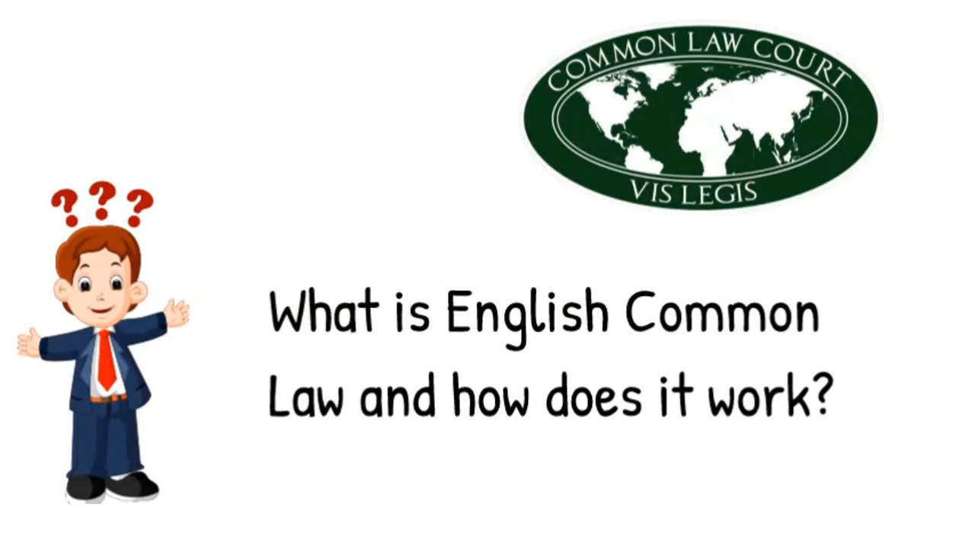

Slide 4
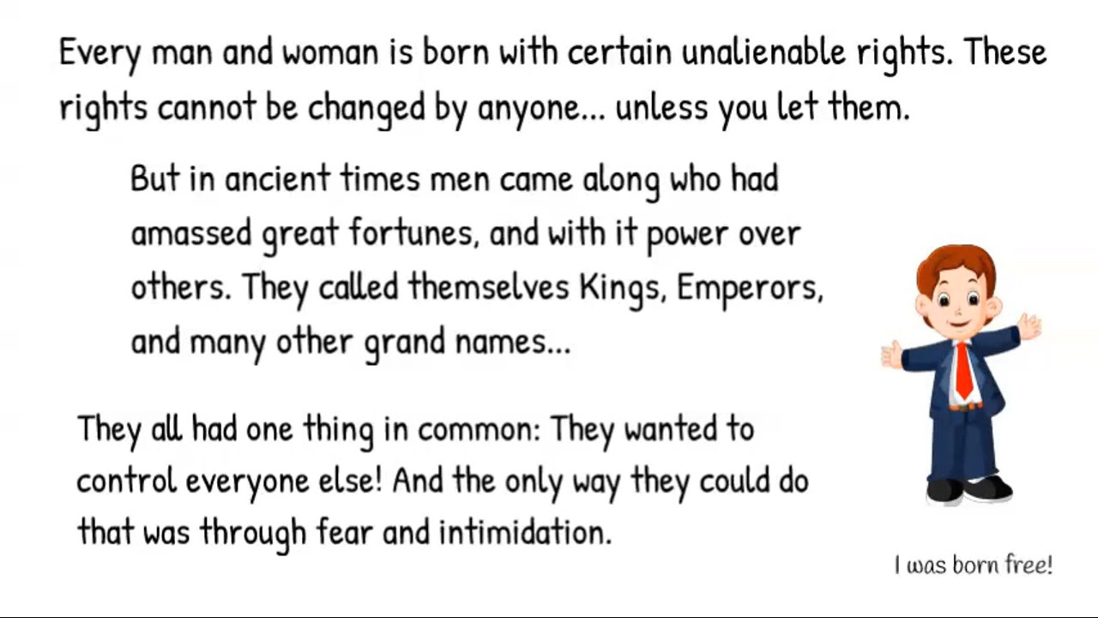

Slide 5
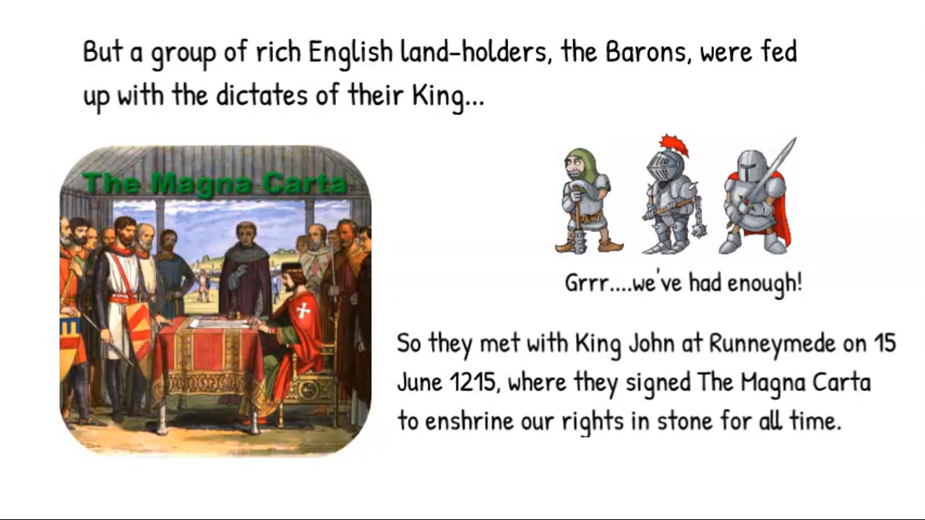

Slide 6
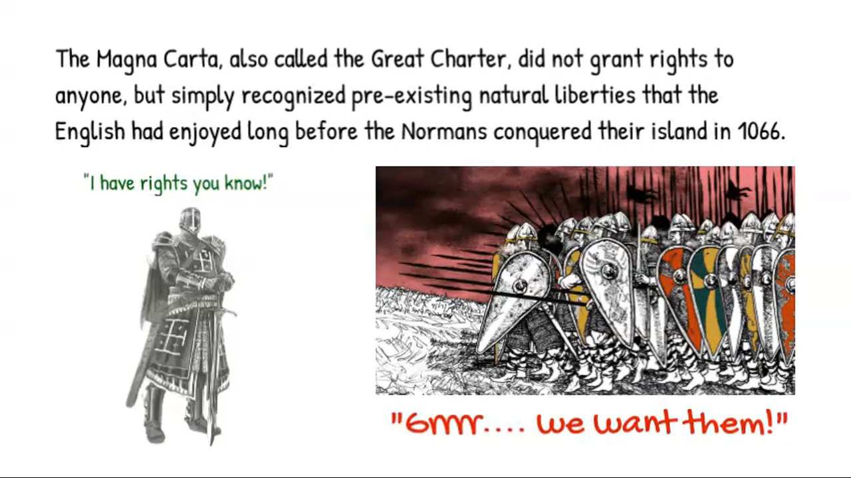

Slide 7
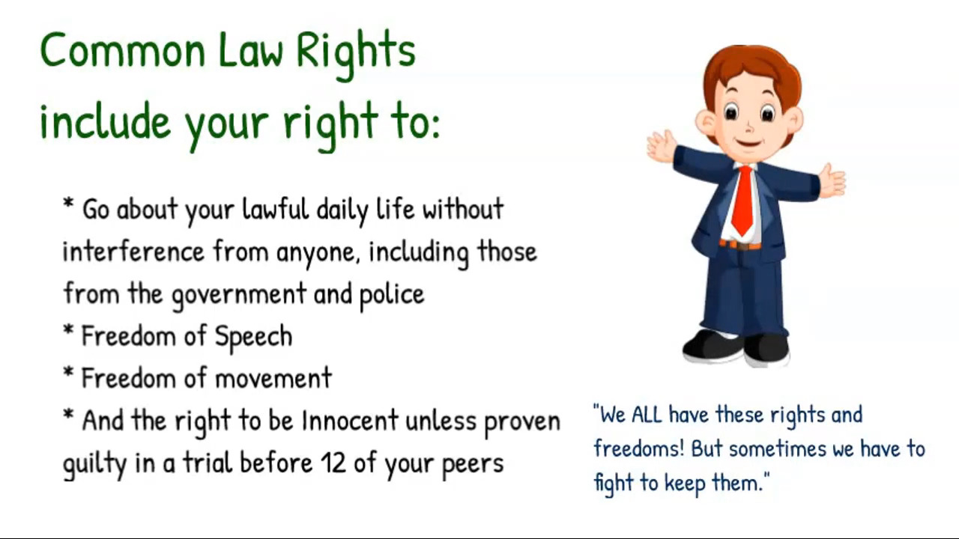

Slide 8
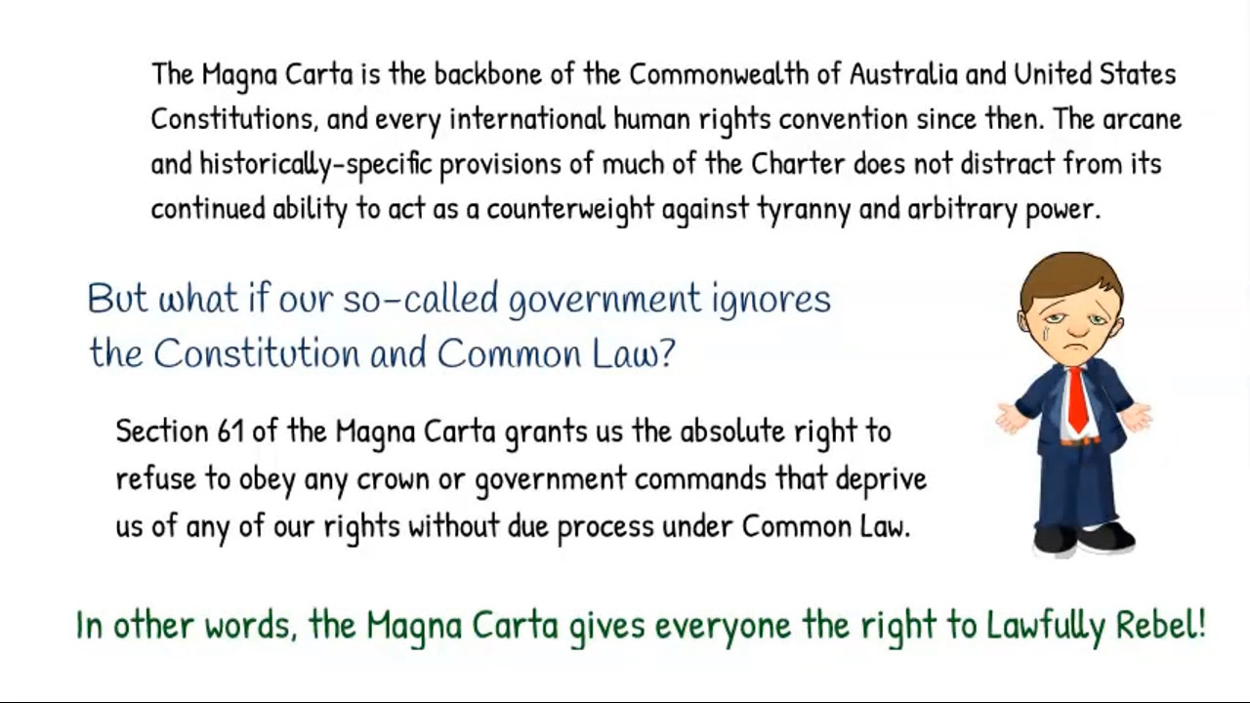

Slide 9
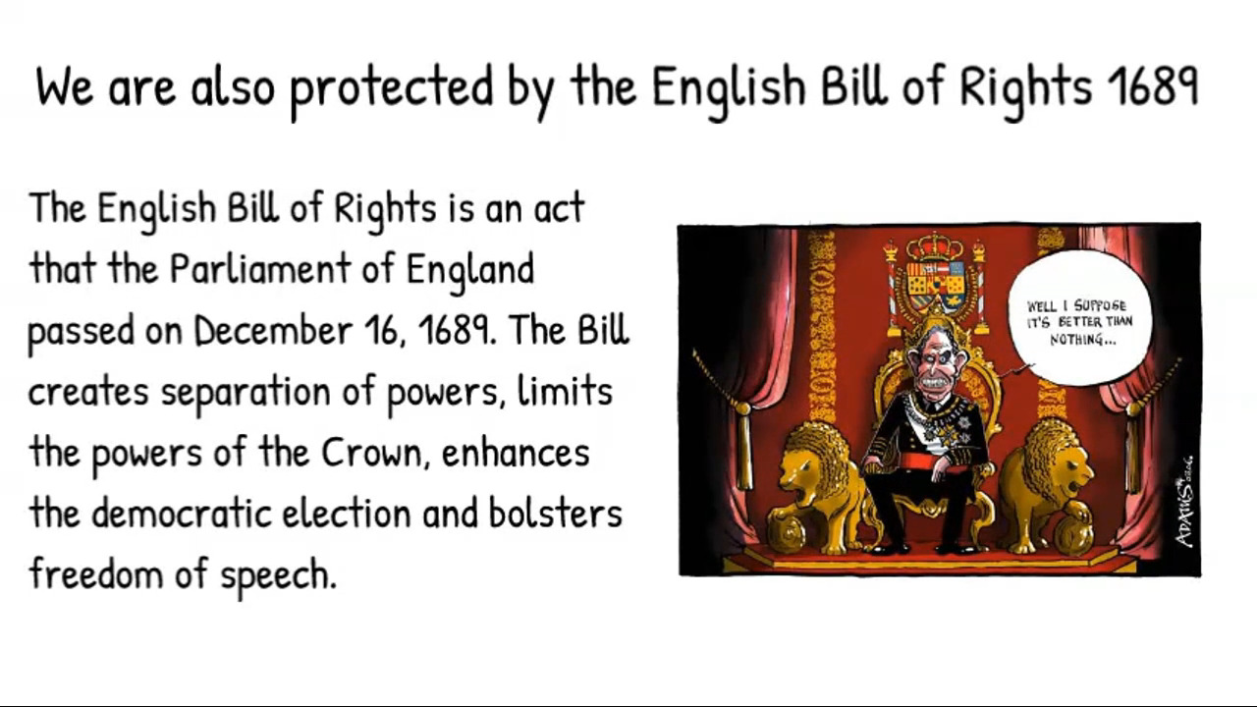

Slide 10
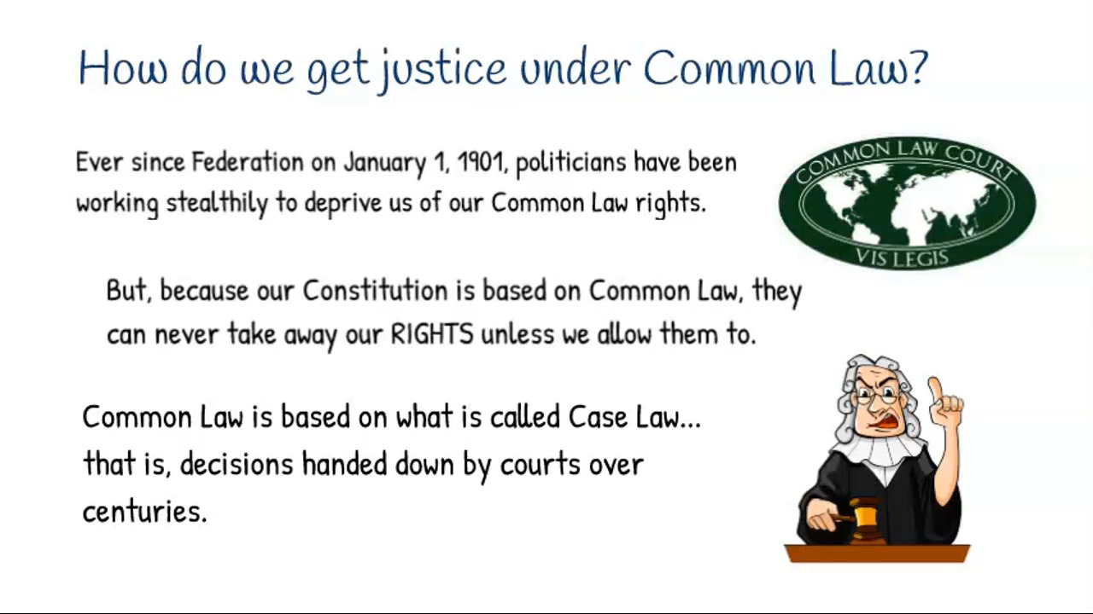

Slide 11
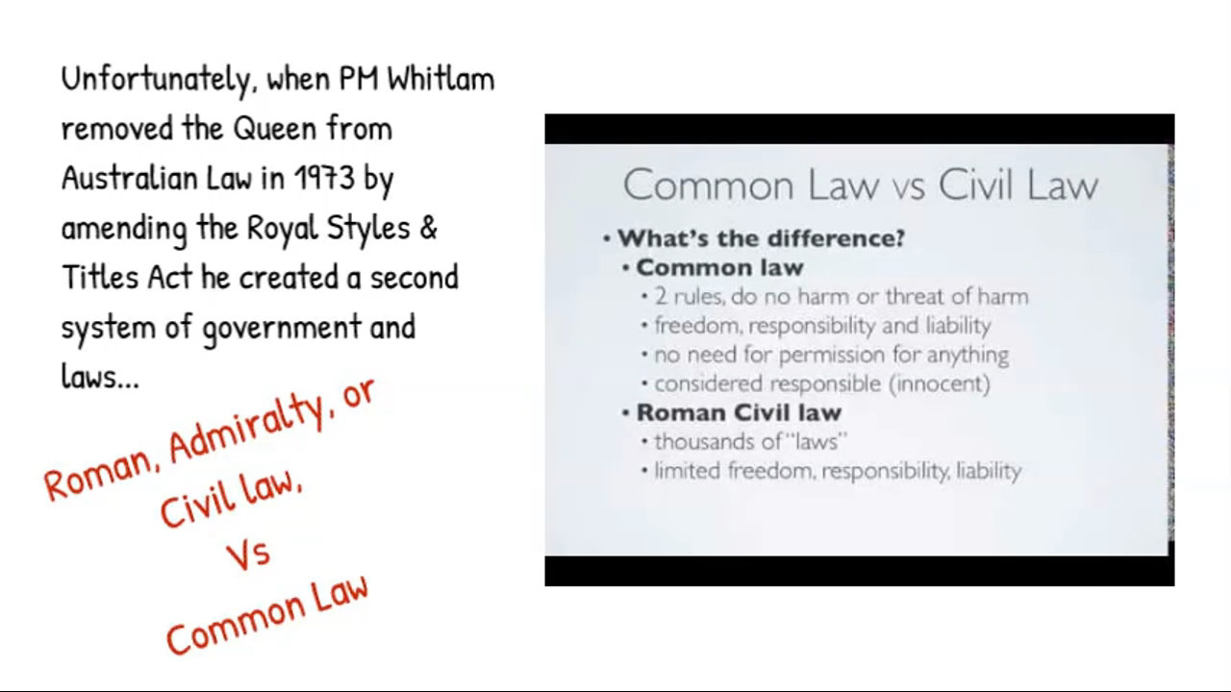

Slide 12
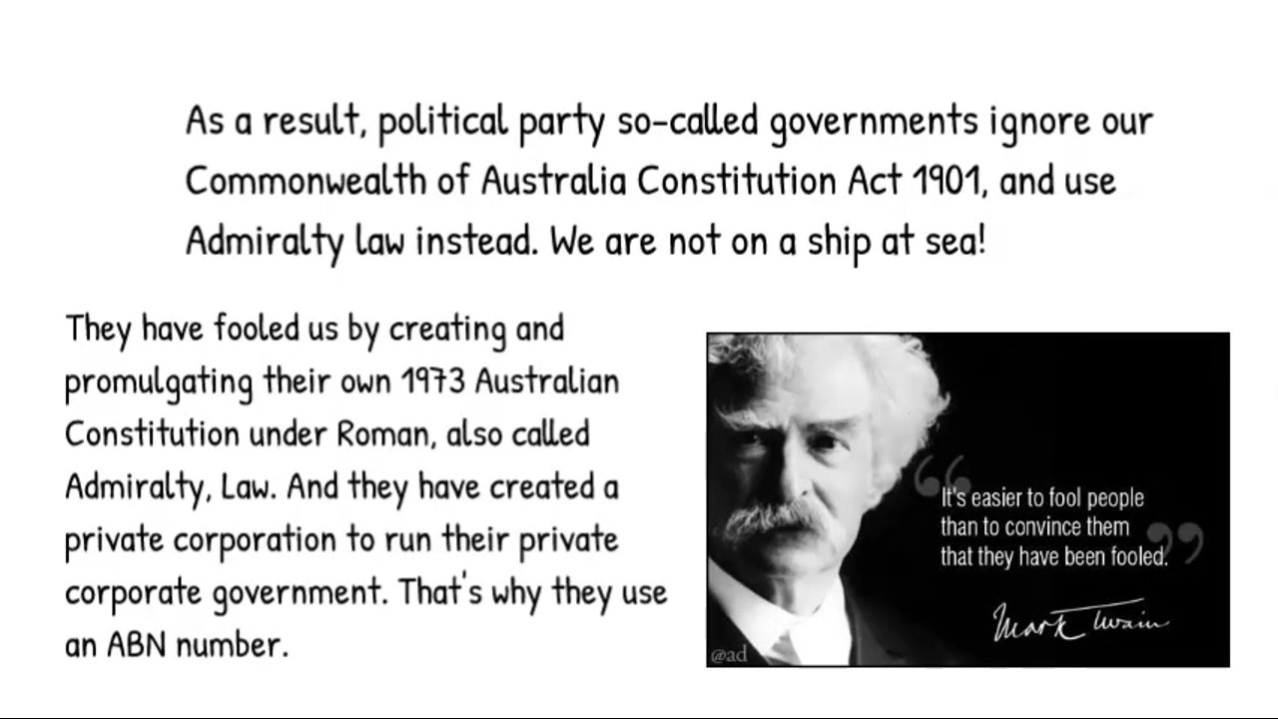

Slide 13
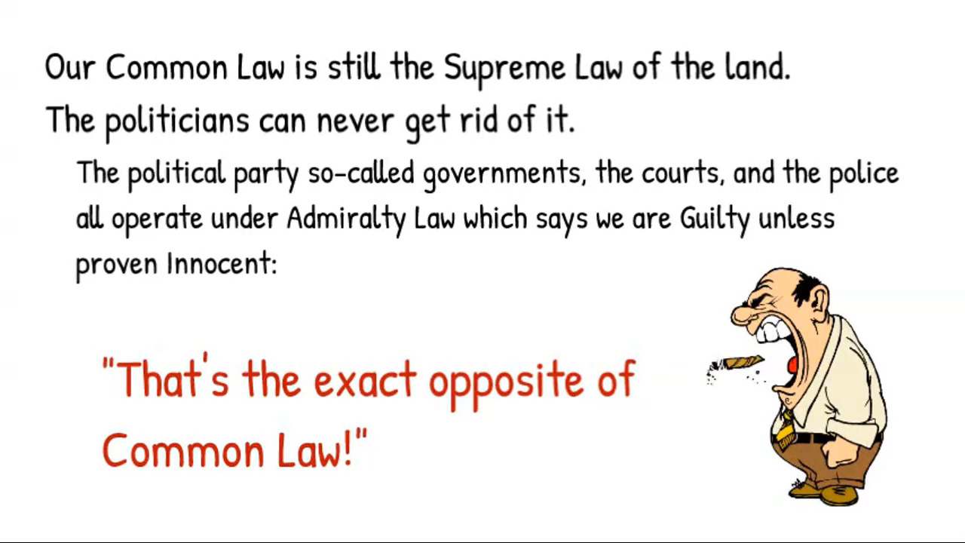

Slide 14


Slide 15
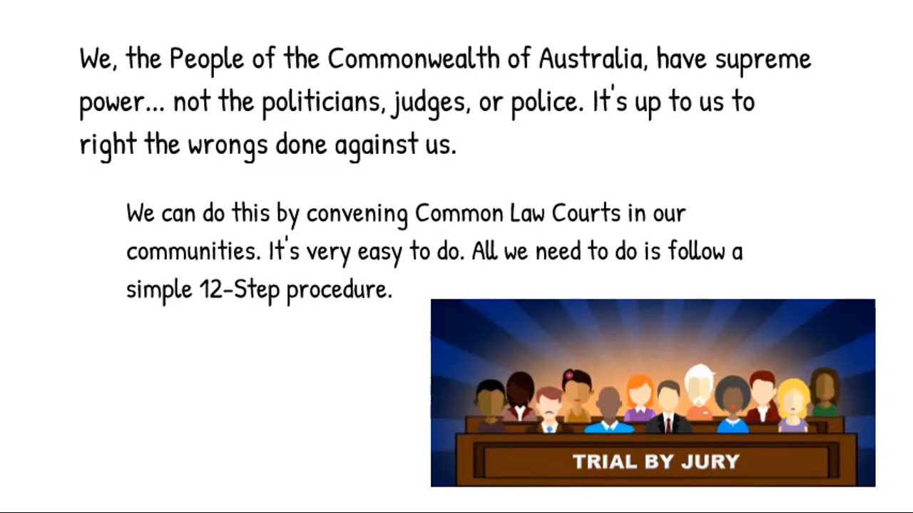

Slide 16
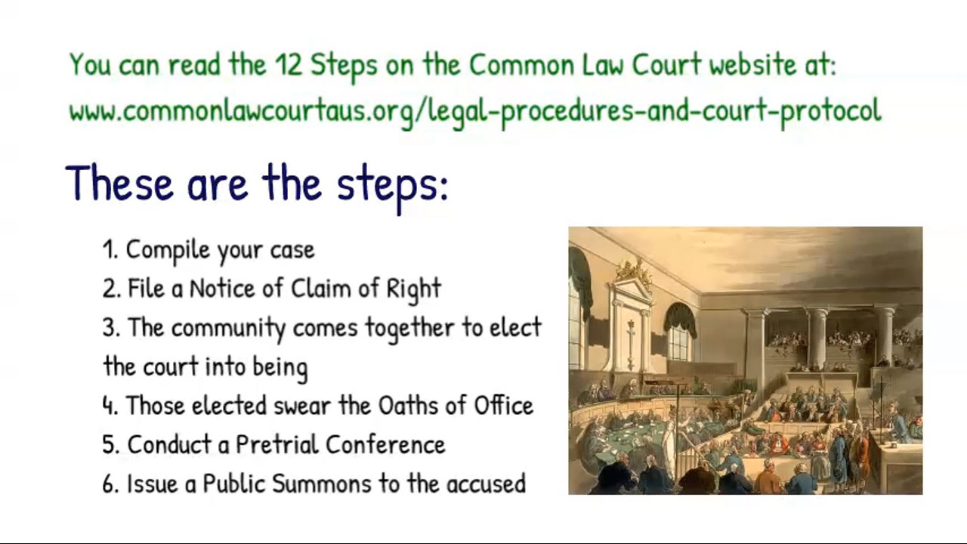

Slide 17
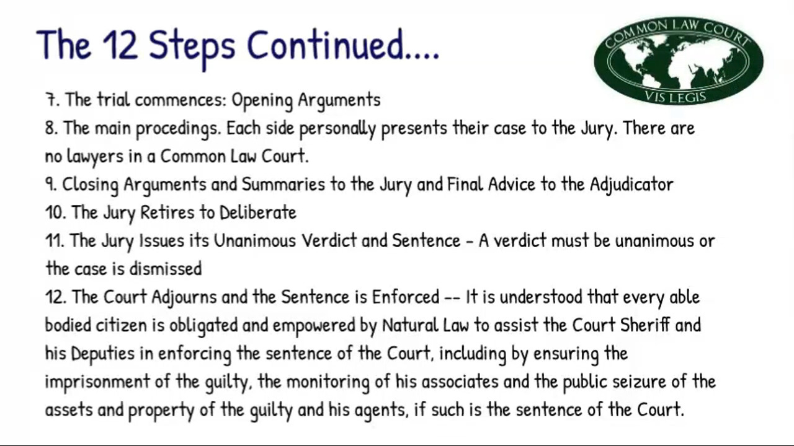

Slide 18
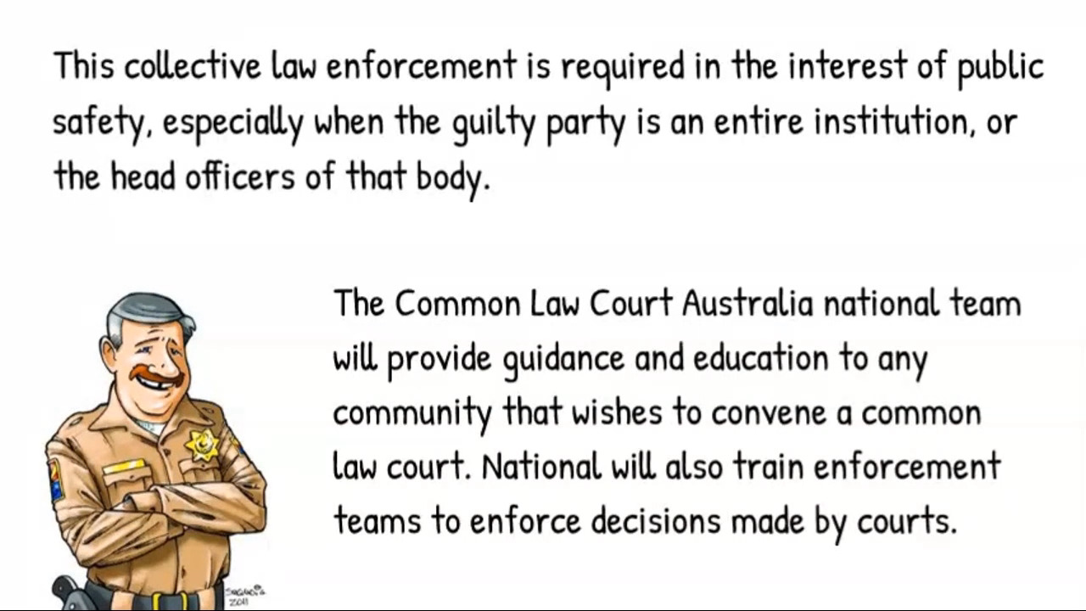

Slide 19
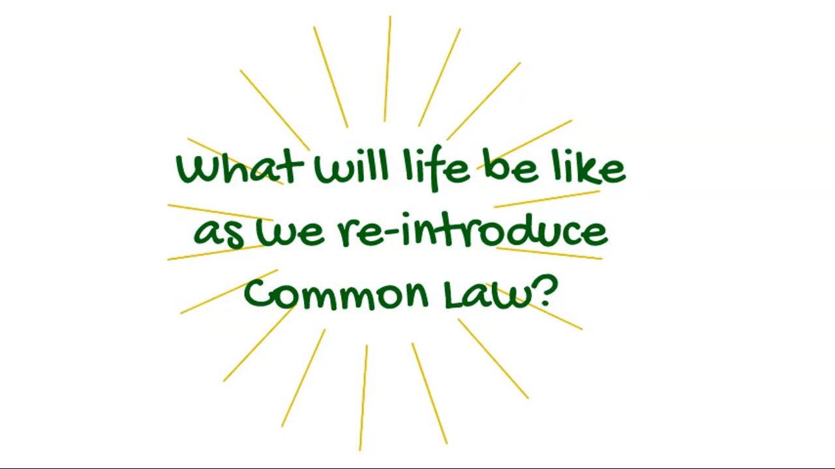

Slide 20


Slide 21
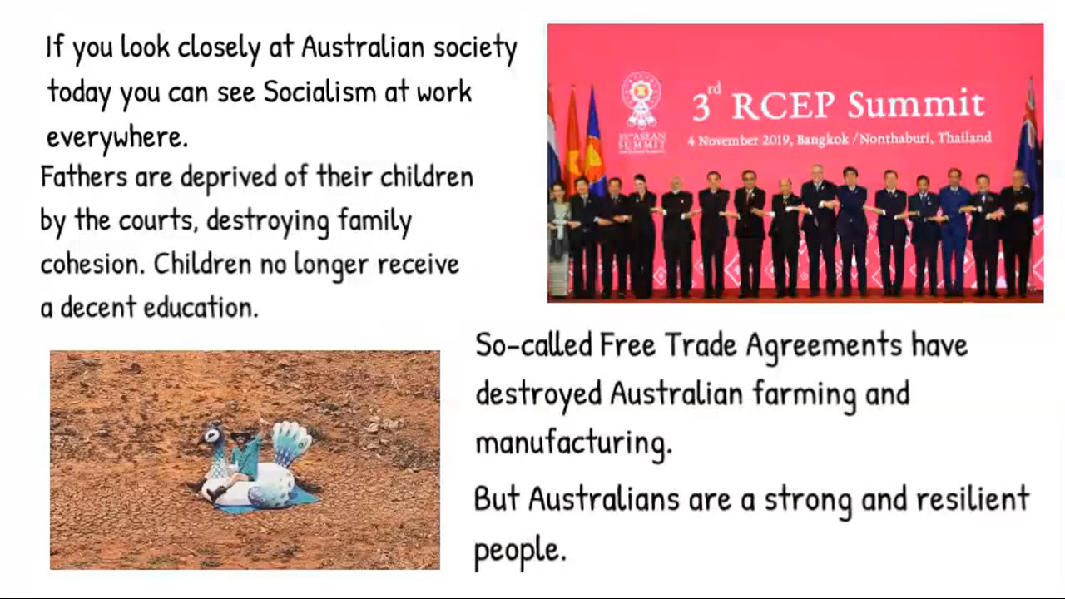

Slide 22
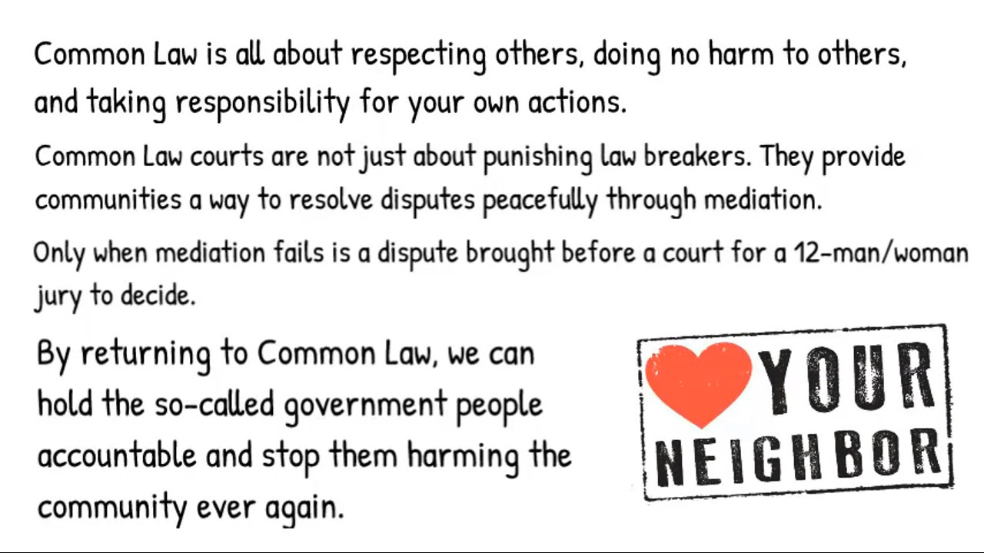

Slide 23
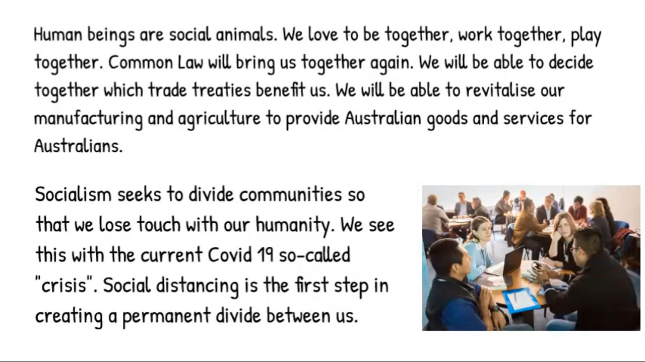

Slide 24
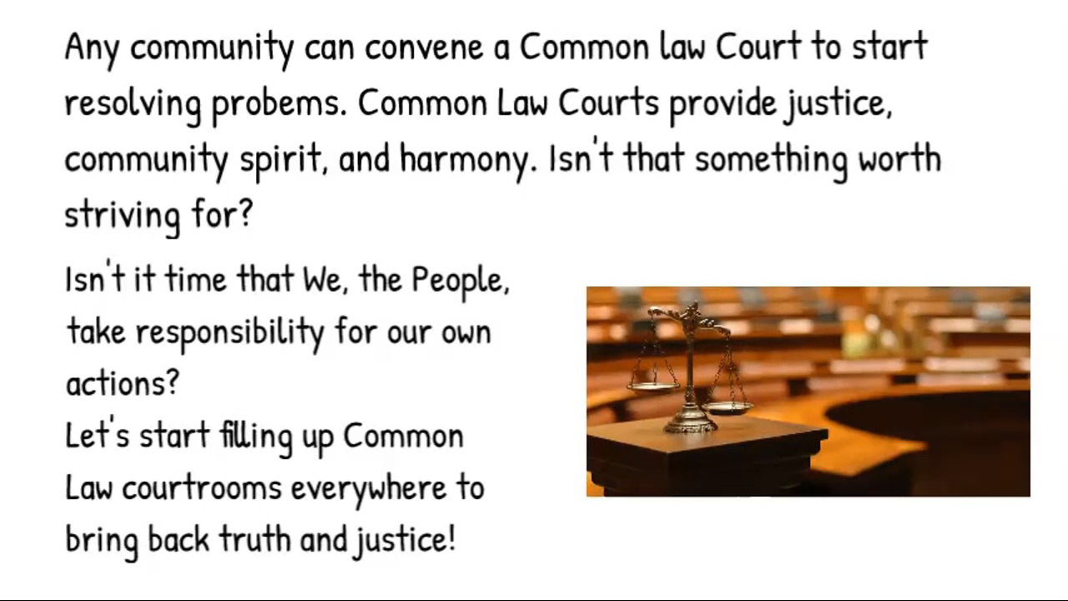

Slide 25


